Slide 1
MULTIPLE EFFECT DISTILLATION (MED) FOR SEAWATER DESALINATION

Slide 2
MULTIPLE EFFECT EVAPORATION DISTILLATION (MED)
Enhancing Sustainability: Harnessing the Power of Multiple Effect Distillation (MED) for Seawater Desalination

Slide 3
MULTIPLE EFFECT DISTILLATION (MED)
The earliest desalination method is multiple-effect distillation (MED), which is very efficient thermodynamically.
The MED process takes place in a sequence of evaporators known as multiple effects, and it works on the premise of lowering ambient pressure.
This method allows the seawater feed to boil numerous times without the need for extra heat after the first effect.
After being preheated in tubes, seawater enters the first effect and is elevated to the boiling point. To encourage quick evaporation, seawater is sprayed onto the surface of evaporator tubes.
Externally supplied steam from a normally dual-purpose power plant heats the tubes.

Slide 4
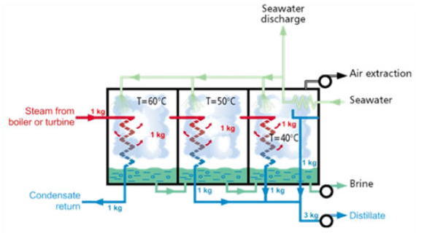

Slide 5
MULTIPLE EFFECT DISTILLATION (MED)
The steam condenses on the opposite side of the tubes, and the steam condensate is recycled as boiler feedwater at the power plant.
The steam economy of the MED plant is related to the number of impacts.
The overall number of effects is constrained by the total temperature range allowed and the minimum temperature difference between each effect.

Slide 6
In the first effect, only a portion of the seawater poured to the tubes evaporates.
The remaining feed water is fed to the second effect and applied to a tube bundle once more.
The vapours produced in the first effect then heat these tubes.
This vapour is condensed into a freshwater product, while a portion of the remaining seawater feed is evaporated in the next effect.
The evaporation and condensation processes are repeated from effect to effect at decreasing pressures and temperatures.
This continues for numerous effects, with a typical large plant having 4 to 21 effects and a performance ratio of 10 to 18 in a large plant.

Slide 7
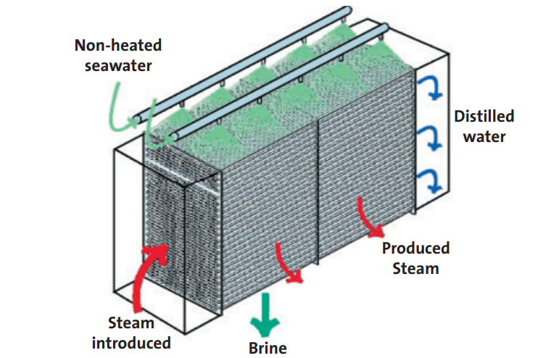

Slide 8
TYPES OFMULTIPLE EFFECT DISTILLATION (MED)
Multiple Effect Distillation (MED)
Multiple Effect Distillation with Thermal Vapour Compression (MED-TVC)
Multiple Effect Distillation with Mechanical Vapour Compression (MED-MVC)
In a sequence of effects, this procedure is repeated (Multiple Effect Distillation).
The produced steam condenses on a traditional shell and tubes heat exchanger in the final cell.
The “distillate condenser,” as it is known, is cooled by seawater. Part of the warmed saltwater is used as make-up for the unit at the condenser’s outlet, while the rest is rejected to the sea.
Brine and distillate are collected from cell to cell until they reach the last one, where centrifugal pumps extract them.

Slide 9
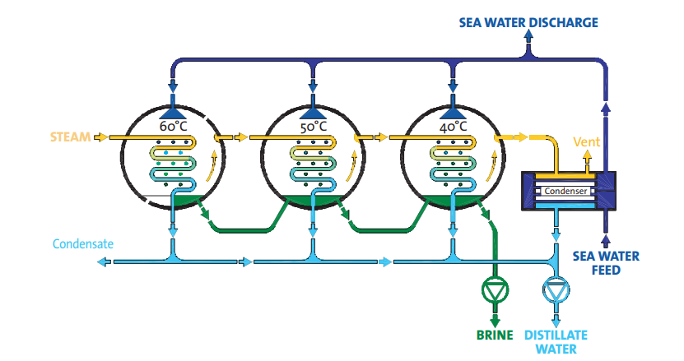
(MED)

Slide 10
MED
The number of kilos of distillate generated per kilo of steam supplied into the system is a measure of the evaporator’s thermal efficiency.
The Gain Output Ratio (GOR) is a term for this figure. The installation of a thermo-compression between one of the cells and the hot one can improve the GOR of the evaporation.
This static compressor will recycle portion of the vapour created in one of the cells into higher pressure vapour to be utilised as heating media for the first one, using LP or MP steam.
An MED evaporator with thermo-compression in a typical configuration (MED-TVC). Whereas the GOR of evaporation would be around 3 (using LLP steam), the GOR of condensation would be around 6. (Using LP or MP steam).

Slide 11
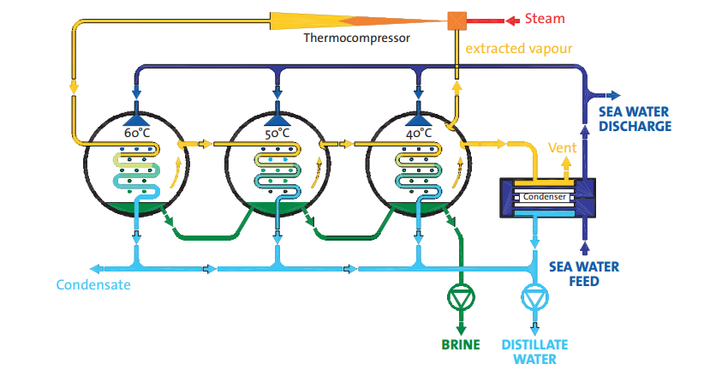
MED

Slide 12
When steam is not available, the MED procedure can still be used with a Mechanical Vapour Compressor (MED-MVC).
A centrifugal compressor powered by an electrical engine recycles the vapour from the cold cell to the hot one in this case.
The system’s electricity usage is in the range of 8 to 15 kWh/m³. The maximum capacity of MED-MVC units is 5000 m³/day due to existing compressor technology limitations

Slide 13
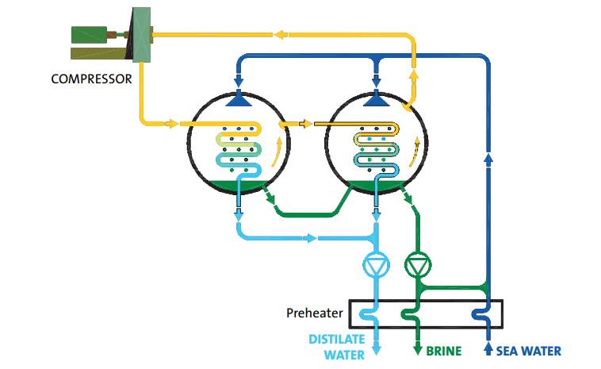
MULTIPLE EFFECT EVAPORATION DISTILLATION (MED)

Slide 14
MULTIPLE EFFECT EVAPORATION DISTILLATION (MED)
The multiple effect evaporation system where it’s not really a schematic, but it looks like a photograph of an existing system that has been done by a leading specialist in water treatment.
It was famous, much more famous working with heat exchangers and cooling towers, this company, and it is also producing units like that.
There are some companies that produce these units not much, by the way, but maybe three, four or five companies throughout the world for producing these desalination systems in general, talking about the large-scale server desalination units.
https://watermanaustralia.com/seawater-desalination-with-multiple-effect-distillation-med/

Slide 15
MULTIPLE EFFECT EVAPORATION DISTILLATION (MED)
Energy Efficiency:
Reduced Steam Consumption: The core advantage is the reuse of steam across multiple stages, minimizing the amount of fresh steam needed.
Lower Energy Costs: Because less steam is required, energy bills are significantly reduced.
Improved Heat Utilization: The latent heat of vaporization is harnessed effectively, maximizing heat transfer.

Slide 16
Cost Savings:
Reduced Operational Costs: Lower steam consumption directly translates to lower operating expenses.
Cost-Effective for Large Volumes: Ideal for processes dealing with large volumes of wastewater or other liquids, where energy savings are substantial.
Reduced Maintenance: In some cases, reduced energy consumption can lead to less wear and tear on equipment, potentially lowering maintenance costs.

Slide 17
Environmental Benefits:
Lower Carbon Footprint:
Reduced steam and energy usage translates to a smaller environmental impact.
Wastewater Management:
Efficiently concentrates and reduces the volume of wastewater, minimizing the environmental impact of industrial processes

Slide 18
Other Advantages:
High Concentration Ratios:
Multiple-effect evaporators can achieve high concentration ratios, which is useful for processes needing concentrated products like fruit juices, dairy, and chemicals.
Scalability:
Systems can be designed with varying numbers of effects to meet specific production needs.
Flexibility:
Can be adapted for various applications and solvents.
Continuous Operation:
Many multiple-effect evaporators are designed for continuous operation, improving throughput and efficiency.

Slide 19
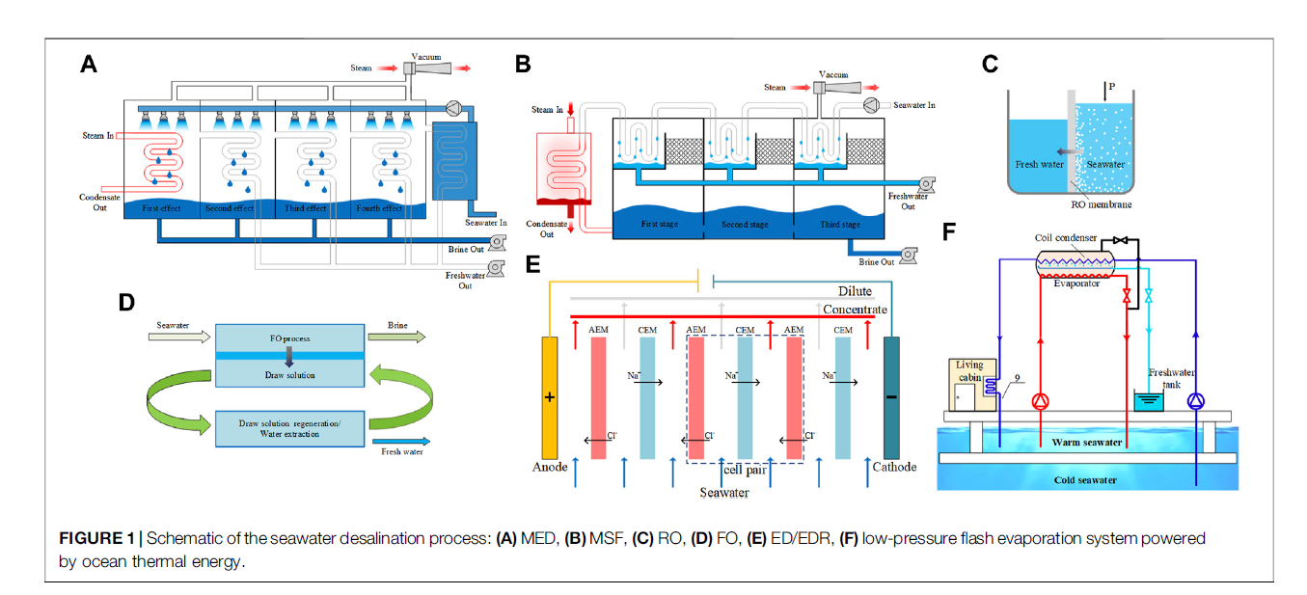

Slide 20
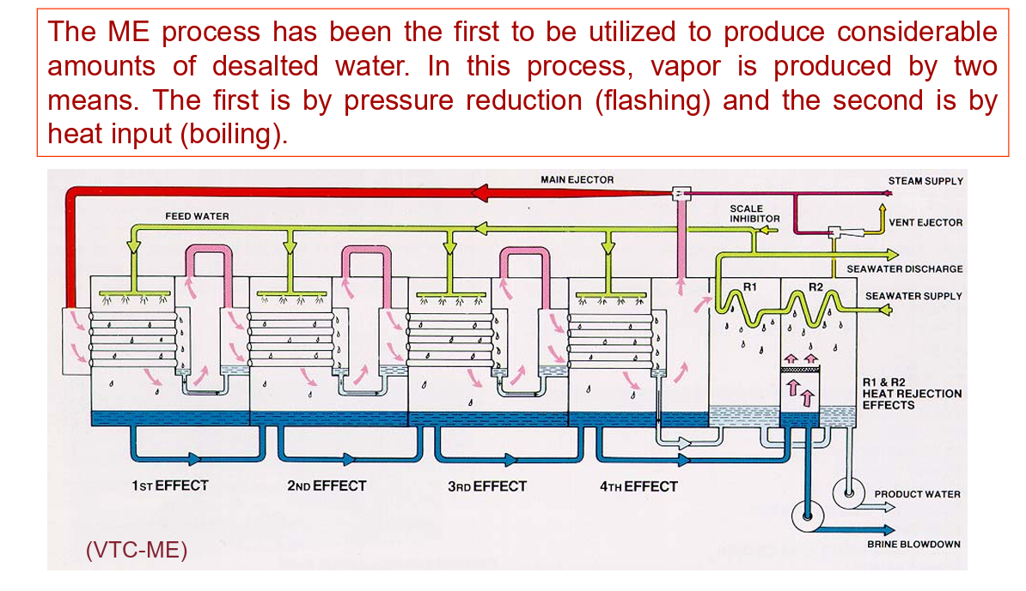

Slide 21
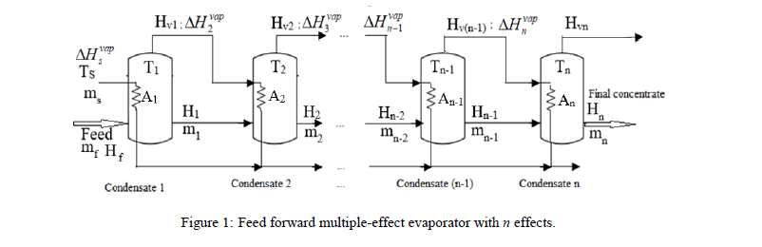
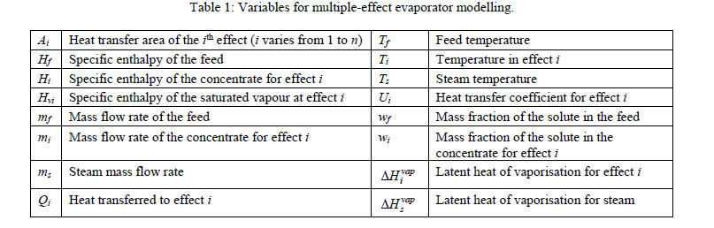

Slide 22
